Slide 1
2023/09/12 Meeting Report

Slide 2
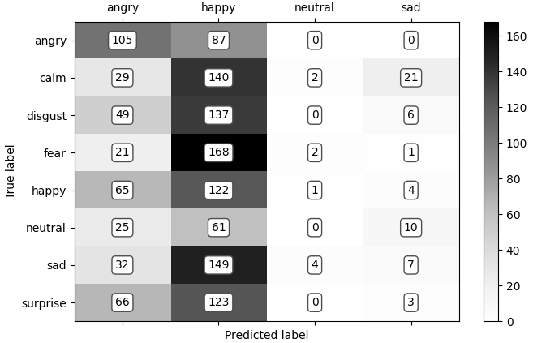
Using RAVDESS test model trained by IEMOCAP
angry | happy | disgust
192 | 192 | 192
fear | calm | neutral
192 | 192 | 96
surprise | sad | total
192 | 192 | 1440
Notes:
一般 learning rate 都會根據 batch size 做一些 scale 的操作。這裏用的是lr x batch_size / 256」。
Learning rate 小 under-fitting
Learning rate 大 unstable

Slide 3
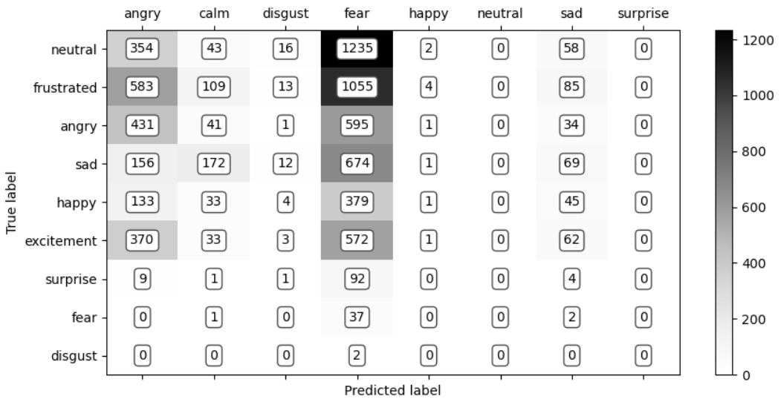
Using IEMOCAP test model trained by RAVDESS
angry | happy | disgust
1103 | 595 | 2
excited | frustrated | fear
1041 | 1849 | 40
neutral | surprise | sad
1708 | 107 | 1084
total
7529
Notes:
一般 learning rate 都會根據 batch size 做一些 scale 的操作。這裏用的是lr x batch_size / 256」。
Learning rate 小 under-fitting
Learning rate 大 unstable

Slide 4
Other emotion speech dataset
Toronto emotional speech set (TESS)
CREMA-D (Crowd-sourced Emotional Multimodal Actors Dataset)
MELD: Multimodal Emotion Lines Dataset
Other depression dataset
DAIC-WOZ
Extended DAIC
Notes:
一般 learning rate 都會根據 batch size 做一些 scale 的操作。這裏用的是lr x batch_size / 256」。
Learning rate 小 under-fitting
Learning rate 大 unstable

Slide 5
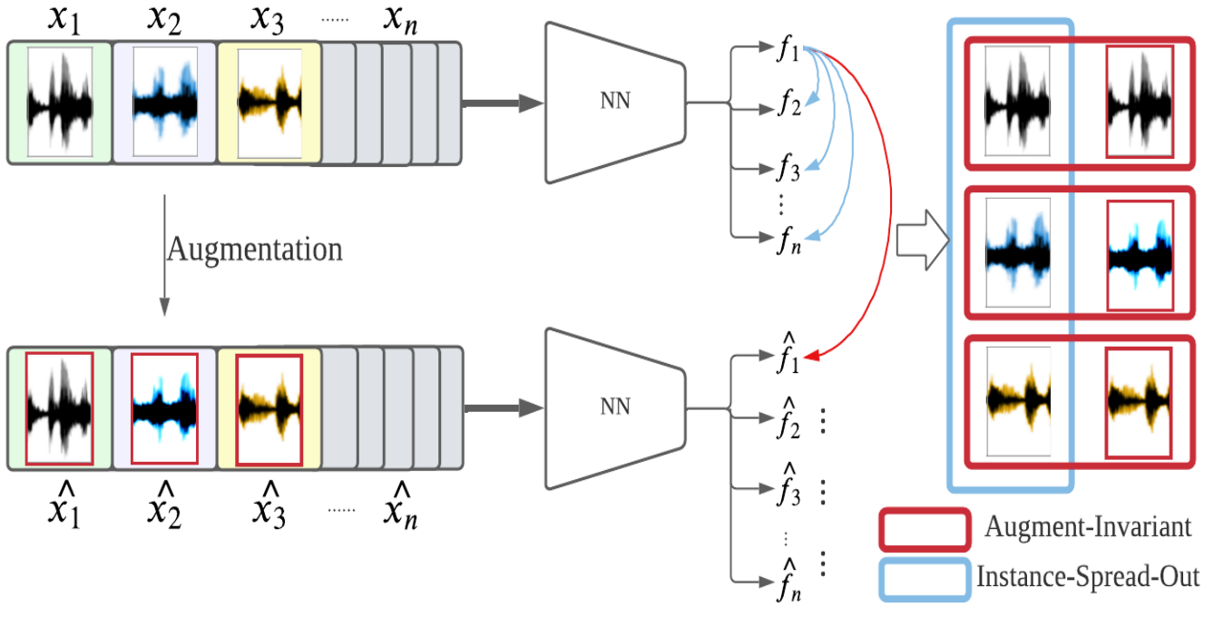
Unsupervised Instance Discriminative Learning for Depression Detection from Speech Signals
Notes:
一般 learning rate 都會根據 batch size 做一些 scale 的操作。這裏用的是lr x batch_size / 256」。
Learning rate 小 under-fitting
Learning rate 大 unstable

Slide 6
Next Step
去看更多利用語音資料檢測憂鬱症相關的論文
找更多憂鬱症相關的語音資料集
Notes:
一般 learning rate 都會根據 batch size 做一些 scale 的操作。這裏用的是lr x batch_size / 256」。
Learning rate 小 under-fitting
Learning rate 大 unstable

